Slide 1
SOCIAL MEDIA MINING FOR HEALTH
MONITORING
Team Alpine
Abhishek Dalvi
Navpinder Singh
Prithvisagar Rao

Slide 2
Problem Definition
We are given with the task of processing the noisy and substantially creative language expressions from social media to extract and classify mentions of Adverse Drug Reactions (ADRs).
The goals of this project are as follows:
Classify the tweets based on mentions of Adverse Drug Reactions(ADRs) .
Identify the text-span of the reported ADRs and distinguish ADRs from similar non-ADR expressions.
Map the extracted colloquial mentions of ADRs in the tweets to standard concept IDs in the MedDRA vocabulary.

Slide 3
Tasks
Task 1:- Detecting Adverse Drug Reactions from tweets
Dataset:- 20,544 train tweets:- 1903(+ve)+18641(-ve)
Approach:- Fine-Tuning Bio-Bert
Task 2:- Extraction of Adverse Effect mentions
Dataset:- 2246 train tweets:- 782(+ve)+1464(-ve)
Approach:- BioWordVec embeddings + Bi-LSTM + CRF
Task 3:- Mapping Adverse Effect mentions to Meddra ID
Dataset:- 2246 train tweets:- 782(+ve)+1464(-ve)
Approach:- Logistic Regression/Graph Embeddings similarity using DeepWalks

Slide 4
Preprocessing
Removing emoticons, url, mentions, Hashtags using tweet-preprocessor library.
Removing punctuations.
Convert characters to lower case.
Lemmatization using TextBlob Lemmatizer
Tokenization on spaces.
! We do not remove Stopwords! Tried out and got poor results

Slide 5
Task 1
Detecting ADR from Tweets

Slide 6
Approach
Dataset is highly skewed (in the ratio of 1:9) so we use weighted sampling for training.
We use Bio-Bert, a Bert model which has been trained on PUBMED and PMC.
Bio-Bert for Sequence classification i.e add the FC-layer at the top of the last pool layer and fine tune it.
Base-Line Approach was a Multinomial Naive Bayes Model with TF-IDF vectors
Other Approaches which we tried out
Bert fine tuning
Bi-Lstm with Attention

Slide 7
Results
Accuracy:- 92.22%
 | Precision | Recall | F1 Score
Positive | 0.54 | 0.67 | 0.60
Negative | 0.97 | 0.94 | 0.95
Macro score |  |  | 0.78
Micro score |  |  | 0.92
Weighted score |  |  | 0.92

Slide 8
Results vs Baseline Result
Accuracy:- 92.22%
 | Precision | Recall | F1 Score
Positive | 0.54(+0.18) | 0.67(+0.05) | 0.60(+0.14)
Negative | 0.97(+0.01) | 0.94(+0.05) | 0.95(+0.03)
Macro score |  |  | 0.78(+0.10)
Micro score |  |  | 0.92(+0.05)
Weighted score |  |  | 0.92(+0.05)

Slide 9
Results vs other approaches results
With the other approaches, the F1 score was between 0.50 to 0.53
Accuracy:- 92.22%
 | Precision | Recall | F1 Score
Positive | 0.54 | 0.67 | 0.60(+0.07 to 0.10)
Negative | 0.97 | 0.94 | 0.95
Macro score |  |  | 0.78
Micro score |  |  | 0.92
Weighted score |  |  | 0.92

Slide 10
Our Results vs Previous Best F-1 score model
Accuracy:- 92.22%
 | Precision | Recall | F1 Score
Positive | 0.54(-0.06) | 0.67(-0.01) | 0.60(-0.04)
Negative | 0.97 | 0.94 | 0.95
Macro score |  |  | 0.78
Micro score |  |  | 0.92
Weighted score |  |  | 0.92

Slide 11
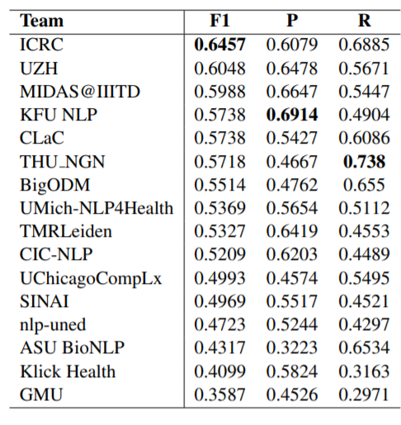
Results from SMM4H 2019 for Task 1:

Slide 12
Task 2
Extracting ADR Mentions Using
BioWordVec+Bi-Lstm+CRF

Slide 13
Data Preparation
Preprocessing/Cleaning
We use the BILOU convention for tagging
B-ADR:- Beginining-ADR
I-ADR:- Inside-ADR
L-ADR:- Last-ADR
U-ADR:- Unit-Last-ADR
O:- Outside/Other
Eg. @ashleylvivian[O] if[O] #avelox[O] has[O] hurt[B-ADR] your[I-ADR] liver[L-ADR], avoid[O] tylenol[O] always[O], eat[O] grapefruit[O] unless[O] taking[O] cardiac[O] drugs[O]

Slide 14
About Bio-WordVec
Trained on Pubmed+PMC and MESH using word2vec.
We use the trigram trained model.
Has an Embedding dimension of 200
We thought would be better than Bio-bert cause:
Bio-bert with a Bi-LSTM CRF would be a really heavy model.

Slide 15
Architecture of
BioWordVec Bi-LSTM+CRF

Slide 16
1. Embed the words
BIOWORDVEC EMBEDDING
words

Slide 17
2. Send it to a 2 layer Bi-LSTM
BIOWORDVEC EMBEDDING
words

Slide 18
3. Convert each timestep features to FC layer to get Tag Features
FC Layer
BIOWORDVEC EMBEDDING
words

Slide 19
4.Add a Start and Stop Tag
<START>
x¹
x²
x³
x⁴
x⁵
x⁶
x⁷
<STOP>
FC Layer
BIOWORDVEC EMBEDDING
words

Slide 20
y⁰
y¹
y²
y³
y⁴
y⁵
y⁶
y⁷
y⁸
<START>
x¹
x²
x³
x⁴
x⁵
x⁶
x⁷
<STOP>
FC Layer
BIOWORDVEC EMBEDDING
words

Slide 21
5. Y represents the token label conditioned on the input feature
y⁰
y¹
y²
y³
y⁴
y⁵
y⁶
y⁷
y⁸
<START>
x¹
x²
x³
x⁴
x⁵
x⁶
x⁷
<STOP>

Slide 22
O
O
O
O
O
O
O
O
O
U-ADR
U-ADR
U-ADR
U-ADR
U-ADR
U-ADR
U-ADR
U-ADR
U-ADR
L-ADR
L-ADR
L-ADR
L-ADR
L-ADR
L-ADR
L-ADR
L-ADR
L-ADR
I-ADR
I-ADR
I-ADR
I-ADR
I-ADR
I-ADR
I-ADR
I-ADR
I-ADR
B-ADR
B-ADR
B-ADR
B-ADR
B-ADR
B-ADR
B-ADR
B-ADR
B-ADR
<START>
x¹
x²
x³
x⁴
x⁵
x⁶
x⁷
<STOP>

Slide 23
5. Perform the forward algorithm to calculate the forward score
6. Calculate the negative log likelihood loss between the forward score and the gold standard path score
7. Perform SGD to get the final values.
y⁰
y¹
y²
y³
y⁴
y⁵
y⁶
y⁷
y⁸
<START>
x¹
x²
x³
x⁴
x⁵
x⁶
x⁷
<STOP>

Slide 24
O
U-ADR
L-ADR
I-ADR
B-ADR
8. For testing you have the trained weights and probabilities but maximum probability doesn’t take into account ” sequence” of state.

Slide 25
O
U-ADR
L-ADR
I-ADR
B-ADR
8. To get the tags for the testing data, perform the Viterbi Decode.

Slide 26
y⁰
y¹
y²
y³
y⁴
y⁵
y⁶
y⁷
y⁸
<START>
x¹
x²
x³
x⁴
x⁵
x⁶
x⁷
<STOP>
FC Layer
BIO-WORDVEC EMBEDDING
words

Slide 27
Results (Strict Evaluation)
Sequence Accuracy:- 50.46% Accuracy:- 91.11%
 | Precision | Recall | F1 Score
I-ADR | 0.451 | 0.302 | 0.362
L-ADR | 0.447 | 0.384 | 0.413
U-ADR | 0.465 | 0.609 | 0.527
B-ADR | 0.425 | 0.367 | 0.394
O | 0.954 | 0.961 | 0.958
Macro score |  |  | 0.531
Micro score |  |  | 0.910
Weighted score |  |  | 0.909

Slide 28
Results (Strict Evaluation) vs BaseLine(CRF)
Sequence Accuracy:- 50.46% (+18.68%) Accuracy:- 91.11%
 | Precision | Recall | F1 Score
I-ADR | 0.451(+0.376) | 0.302(+0.177) | 0.362(+0.268)
L-ADR | 0.447(+0.348) | 0.384(+0.214) | 0.413(+0.288)
U-ADR | 0.465(+0.302) | 0.609(+0.498) | 0.527(+0.395)
B-ADR | 0.425(+0.314) | 0.367(+0.226) | 0.394(+0.253)
O | 0.954 | 0.961 | 0.958
Macro score |  |  | 0.531(+0.255)
Micro score |  |  | 0.910(+0.010)
Weighted score |  |  | 0.909(+0.003)

Slide 29
Results (Strict Evaluation) vs Previous Best F-1 score model
Sequence Accuracy:- 50.46% Accuracy:- 91.11%
 | Precision | Recall | F1 Score
I-ADR | 0.451 | 0.302 | 0.362
L-ADR | 0.447 | 0.384 | 0.413
U-ADR | 0.465 | 0.609 | 0.527
B-ADR | 0.425 | 0.367 | 0.394
O | 0.954 | 0.961 | 0.958
Macro score |  |  | 0.531
Micro score |  |  | 0.910
Weighted score |  |  | 0.909
0.424
(-0.04)

Slide 30
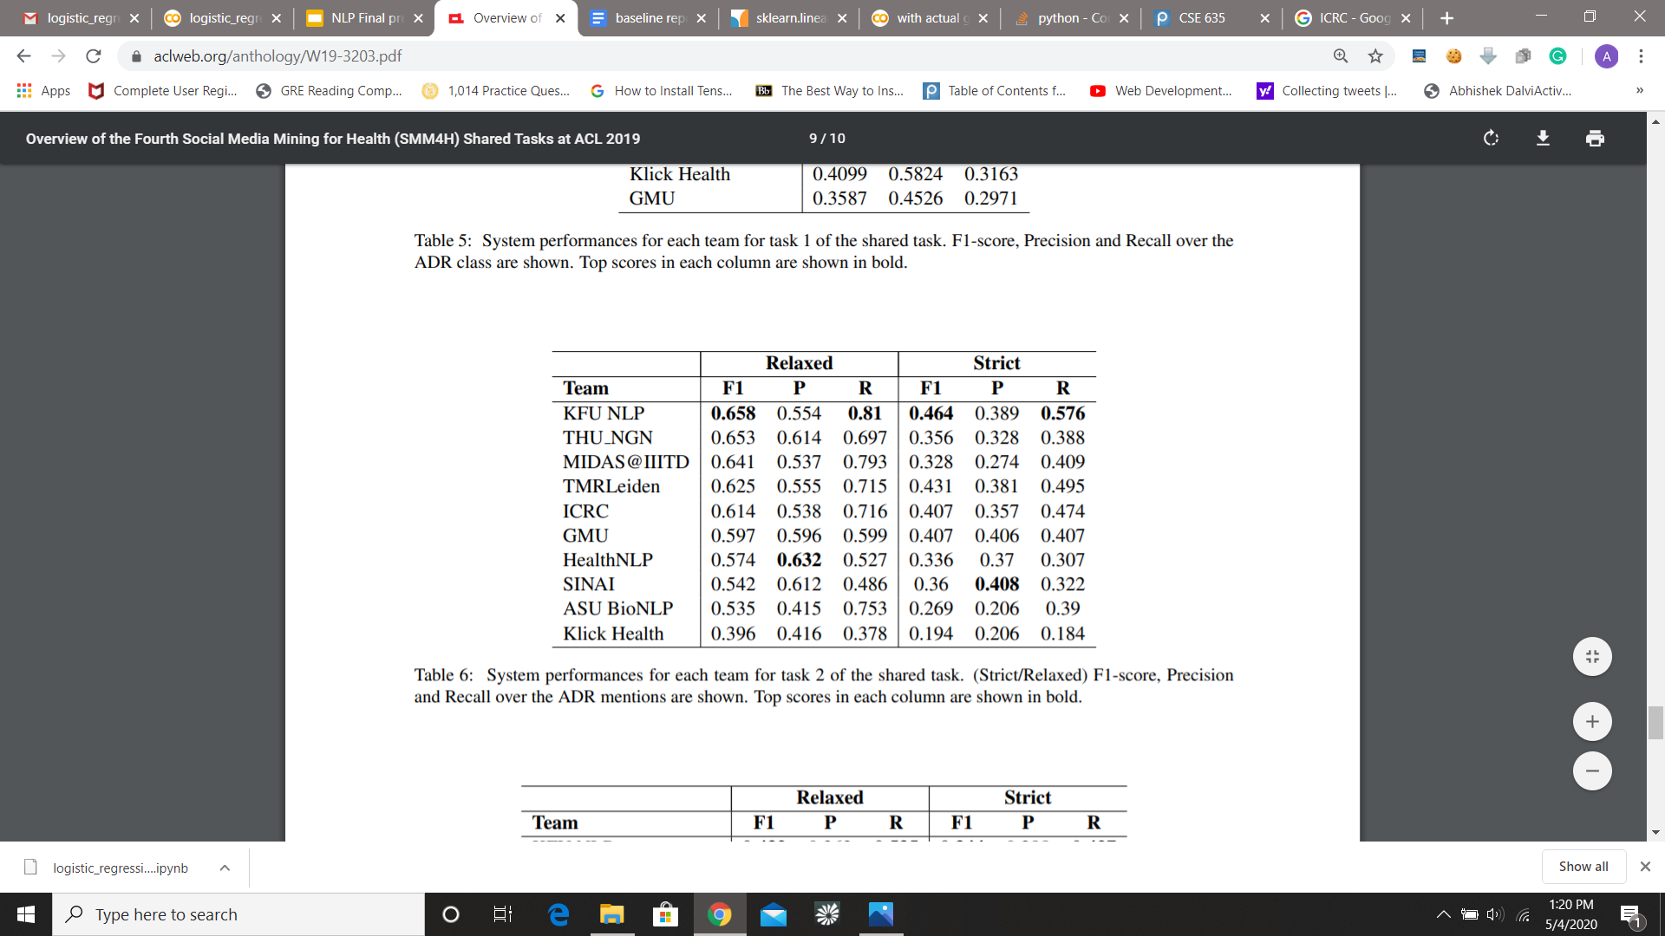
Results from SMM4H 2019 for Task 2- Strict:

Slide 31
Results (Relaxed Evaluation)
Sequence Accuracy:- 50.70% Accuracy:- 92.23%
 | Precision | Recall | F1 Score
ADR | 0.587 | 0.544 | 0.565
O | 0.954 | 0.961 | 0.958
Macro score |  |  | 0.761
Micro score |  |  | 0.922
Weighted score |  |  | 0.921

Slide 32
Results (Relaxed Evaluation) vs Baseline(CRF)
Sequence Accuracy:- 50.70%(+14.80) Accuracy:- 92.23%
 | Precision | Recall | F1 Score
ADR | 0.587(+0.292) | 0.544(+0.168) | 0.565(+0.234)
O | 0.954 | 0.961 | 0.958
Macro score |  |  | 0.761(+0.124)
Micro score |  |  | 0.922
Weighted score |  |  | 0.921

Slide 33
Results from SMM4H 2019 for Task 2- Relaxed:

Slide 34
Attempted Techniques/Models
Bio-Bert For token classification
RO-BERTA and BART models

Slide 35
Task 3
Logistic Regression on Trained Embeddings from task 2

Slide 36
Problems Faced
The main issue over here that there wasn’t enough data.
Highly unbalanced data; around 1400 training samples having 416 classes, out of which most were about weight gain and anxiety.
Some of the Meddra IDs or term encountered in the Test data are not present in the train data.
Meddra terms having the same diagnosis have different meddra-ids, eg. weight gain and weight increase have a different meddra-id
Approaches we tried
SVM, NB, Logistic Regression on embeddings
Fine tuning clinical bert.
Creating a graphical model and performing Deep Walks on it to get the graph Embeddings.

Slide 37
Deep walk approach
Creating a graph where nodes are tokenized extractions, tokenized meddra terms, drug mention and meddraID.
Connecting all these Nodes.
Then use Deep Walks
Perform random short walks on the graph
Send these walks as sentences in Word2Vec skip-gram model to get the node embeddings

Slide 38
Results(only positive labels)
 | Precision | Recall | Macro F1 Score | Micro
LR on word embed | 0.234 | 0.281 | 0.261 | 0.371
Deepwalks | 0.275 | 0.313 | 0.193(!0.295) | 0.290(!0.38)
SVM | 0.465 | 0.609 | 0.180 | 0.262

Slide 39
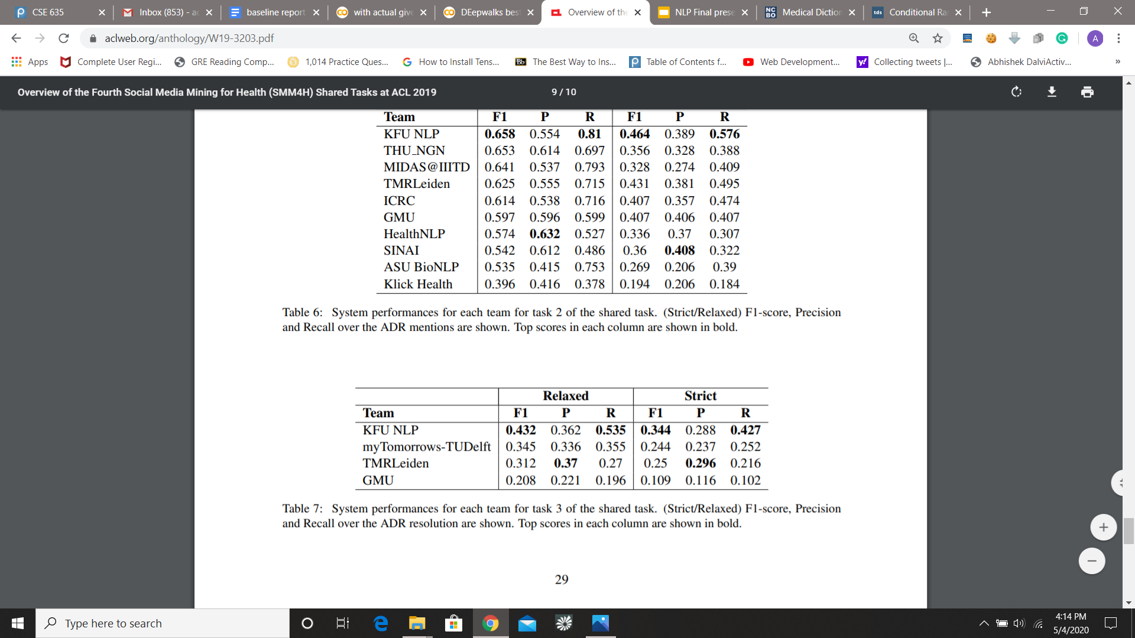
Results from SMM4H 2019 for Task 3

